Slide 1
Bergen Animal Shelter
Feathers and Fur

Slide 2
Policies
Adoption
Rescue
Public Health
Wildlife

Slide 3
Programs
Education
Adoption
Vaccination
Spay & Neuter
Volunteer

Slide 4
Animals
Dogs
Cats
Birds
Rabbits

Slide 5
New ventures at home
Birds
Fish
Turtles

Slide 6
Organization
Arianna Benjamin
President
Sarah Chu
Vice President
Ellyn Martinson
Treasurer
Rachel Dumont
Secretary
Monday | Wednesday | Friday
Bill | Bob | Stan
Fred | Al | George
Artie | Phil | Sam
Notes:
Remember to thank Rita for planning the fundraiser

Slide 7
Funds Raised This Year

Slide 8
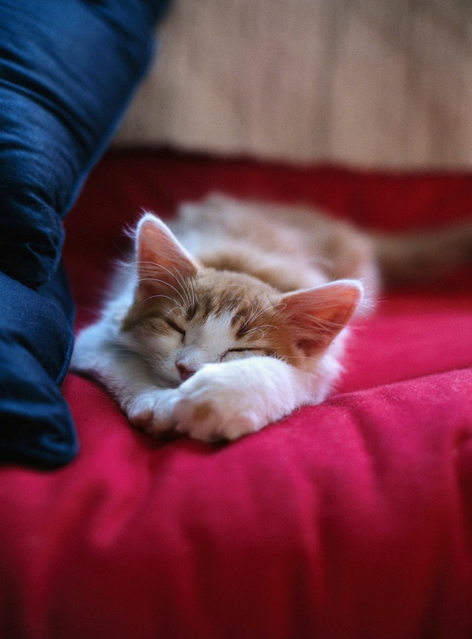
Animals For Adoption
I’m 8 weeks old
I’m a girl kitten
I’m soft and fluffy
I love children
My name is Lacie

Slide 9
Animals For Adoption
5 years old
Orange tabby
Male
Loves kids
All shots

