Slide 1
PowerPoint Lesson 1 Microsoft PowerPoint Basics
Microsoft Office 2010 Introductory
Pasewark & Pasewark

Slide 2
Objectives
Start PowerPoint, and understand the elements of the PowerPoint window.
Open an existing presentation, and save it with a new name.
Navigate a presentation and change views.
Use the Slides and Outline tabs and the Slide and Notes panes.
2
2

Slide 3
Objectives (continued)
Change the layout on a slide.
Delete a slide.
Print a presentation.
Exit PowerPoint.
3
3

Slide 4
Vocabulary
animation
broadcasting
handouts
layout
Live Preview
Normal view
Notes Page view
Notes pane
Outline tab
PowerPoint presentation
Reading view
Slide pane
Slide Show view
Slide Sorter view
Slides tab
thumbnails
transition
4
4

Slide 5
Introduction to PowerPoint
PowerPoint is a program used to create professional presentations.
Presentations can include:
text
graphics
tables
charts
audio
video
flash animation files
animated clip art
movie clips
links to Web sites
5
5

Slide 6
Starting PowerPoint
Click the Start button on the taskbar.
Click All Programs on the Start menu.
Click the Microsoft Office folder.
Click Microsoft Office PowerPoint 2010.
6
6

Slide 7
Reviewing the PowerPoint Window
The PowerPoint window shares several common elements and tools with other Office programs.
Normal view allows you to add and delete slides, and add text and elements to slides.
The Home tab is the default tab on the Ribbon and includes many of the commands you will use most often.
7
7

Slide 8
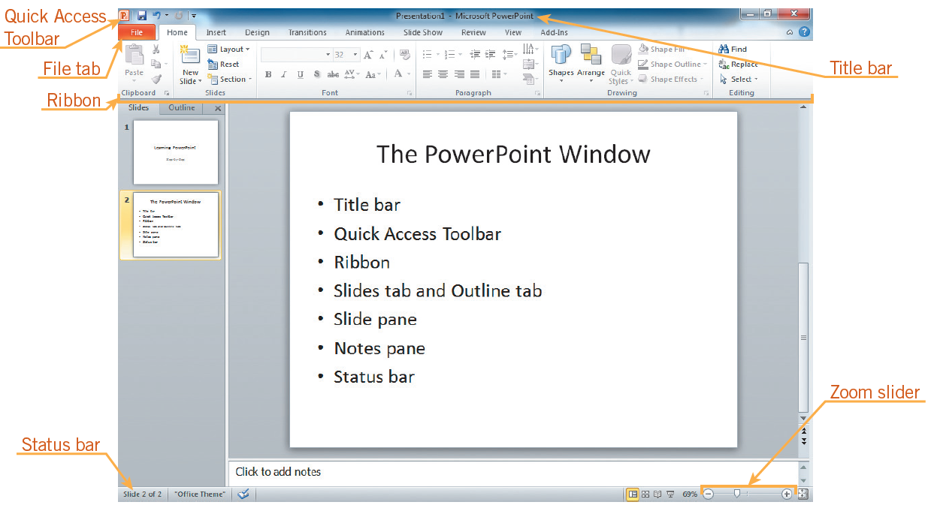
Reviewing the PowerPoint Window (continued)
PowerPoint window in Normal view
8
8

Slide 9
Opening an Existing Presentation and Viewing a Slide Show
To open a recently viewed presentation, you can choose the presentation from the Recent Presentations list in Backstage view.
To view the presentation as a slide show, click the Slide Show button on the status bar.
9
9

Slide 10
Opening an Existing Presentation and Viewing a Slide Show (continued)
A slide show is a series of slides.
Transition refers to the way each new slide appears on the screen.
An animation is an effect you can apply to text, objects, graphics, or pictures to make those objects move during a slide show
10
10

Slide 11
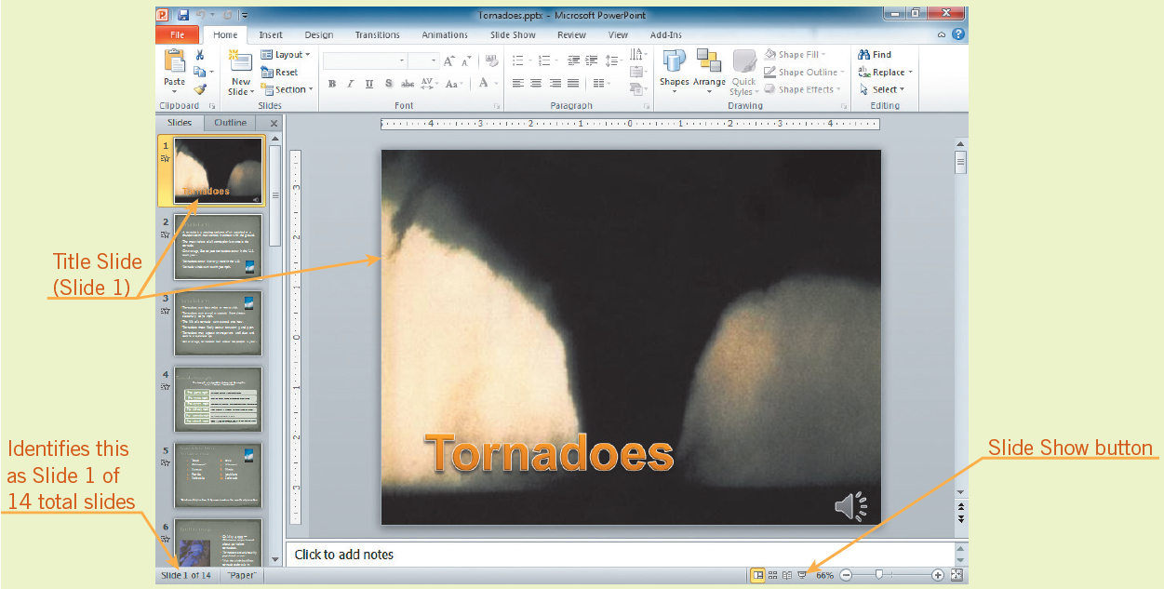
Opening an Existing Presentation and Viewing a Slide Show (continued)
Title slide for Tornadoes presentation

Slide 12
Saving a Presentation
To save a new presentation the first time, you use the Save As command.
The next time you want to save changes to your presentation, click the Save button on the Quick Access Toolbar or press Ctrl+S.
12
12

Slide 13
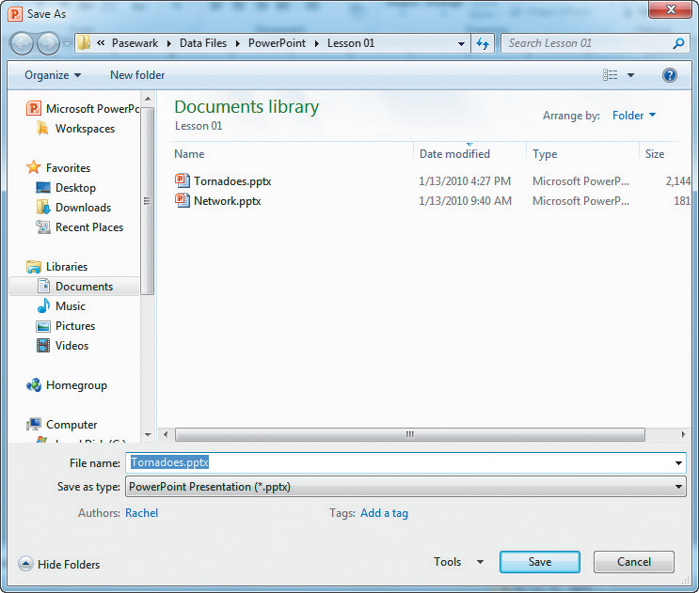
Saving a Presentation (continued)
Save As dialog box
13
13

Slide 14
Changing Views
You can view a presentation in five ways:
Normal view: Where you do most of your work.
Reading view: Slide almost fills screen.
Slide Sorter view: Displays thumbnails of your slides so you can easily rearrange them.
Slide Show view: Your presentation is shown full screen as if being seen by an audience.
Notes Page view: Displays slides on top of the page and speaker notes below.
14
14

Slide 15
Changing Views (continued)
To change views:
Go to the Presentation Views group on the View tab.
View shortcuts on the status bar.

Slide 16
Changing Views (continued)
In Normal View you can have up to four panes:
Slides tab and Outline tab: Slides tab shows thumbnails of your slides and Outline tab shows text in an outline format.
Slide pane: Displays one slide at a time, and offers an opportunity to edit text.
Notes pane: Where you add speaker notes.
Task pane: Opens up on the right for some tasks such as inserting clip art.
.
16
16

Slide 17
Changing Views (continued)
The Ribbon contains commands for the tasks you will use when creating presentations.
The Live Preview feature lets you preview a theme before applying it in your presentation.
The Slide pane is the workbench for PowerPoint presentations, displaying slides in a large work area.
17
17

Slide 18
Inserting a New Slide with a New Slide Layout
You can choose a layout when you insert a new slide or change the layout of an existing slide.
Slide layout: How objects are placed on a slide.
Objects: Text, images, illustrations, tables, media, and charts.
Default layout: Includes placeholders for titles, text, and content.
18
18

Slide 19
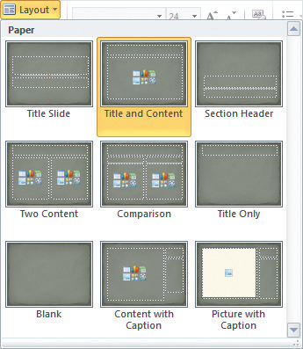
Inserting a New Slide with a New Slide Layout (continued)
Default layouts

Slide 20
Notes Page View
Notes Page view displays your slides on the top of the page, with speaker appearing in the Notes pane on the bottom of the page.
You can use the notes to help guide you during the presentation.
Notes are also helpful if you print a handout for your audience.

Slide 21
Using Slide Sorter View
Slide Sorter view displays thumbnails of the slides so that you can move and arrange slides easily by clicking and dragging.
Slide Sorter view gives you an overview of the entire presentation.
21
21

Slide 22
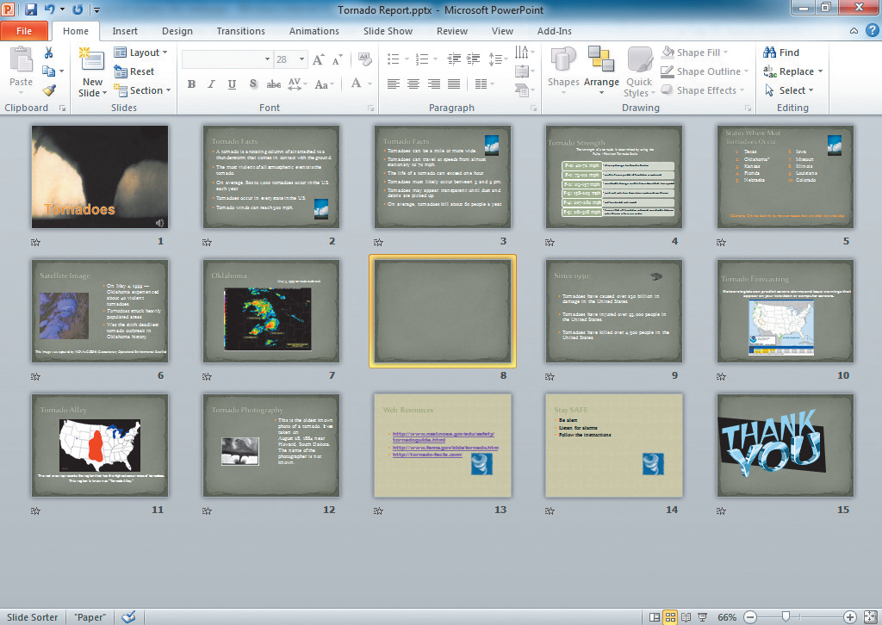
Using Slide Sorter View (continued)
Slide sorter view

Slide 23
Using Slide Show View
In Slide Show view, you run your presentation on your computer as if it were a slide projector.
Each slide fills the screen and any animations, sounds, and videos included in the presentation play.
23
23

Slide 24
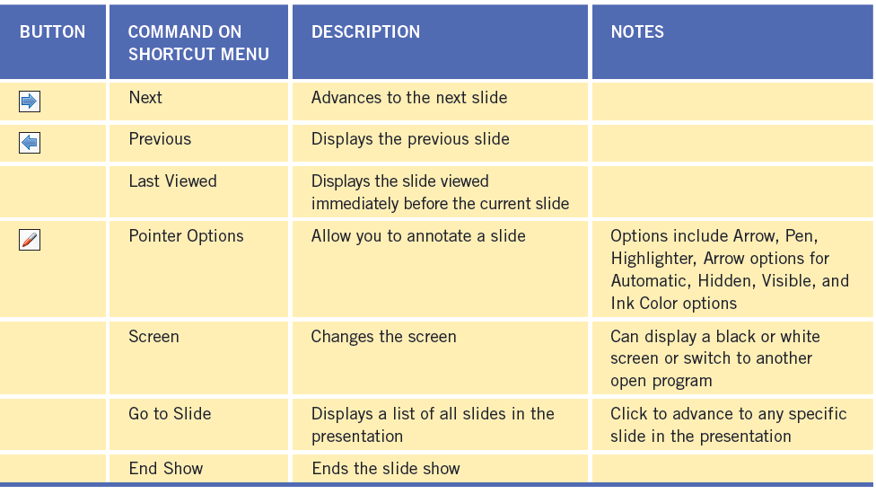
Using Slide Show view (continued)
Move the mouse to the lower-left corner of the screen as the slide show runs to access Slide Show toolbar.
Commonly-used commands in Slide Show view

Slide 25
Using Reading View
In Reading view, the slide does not quite fill the screen and displays navigation buttons.
Slide in Reading view
25
25

Slide 26
Deleting Slides
In Normal view, display the slide you want to delete, press Delete on the keyboard.
You can also delete a slide, by right-clicking the slide, then click Delete Slide on the shortcut menu.
If you accidentally delete a slide, click the Undo Delete Slide button on the Quick Access Toolbar to restore the slide.
26
26

Slide 27
Printing a Presentation
PowerPoint offers several print options, including:
Print all slides or a text outline of your presentation.
Print handouts with 2 to 9 slides per page.
Print only the current slide, or any combination of slides in your presentation.
27
27

Slide 28
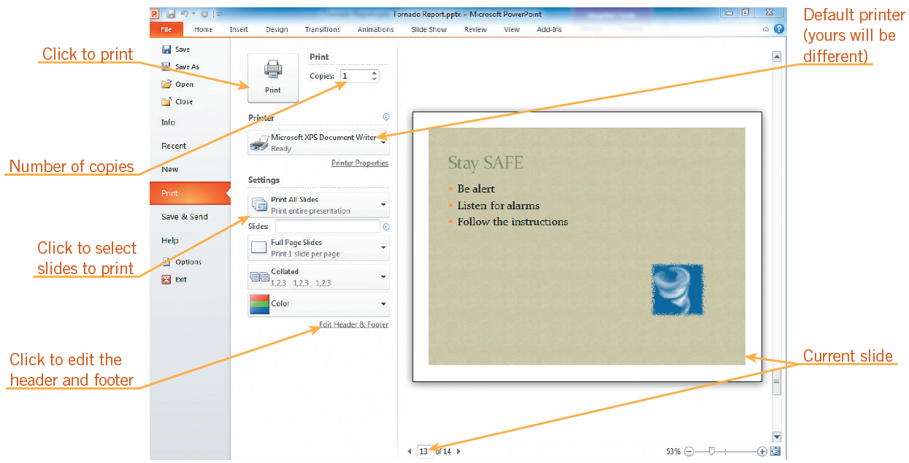
Printing a Presentation (continued)
Print options
28
28

Slide 29
Closing a Presentation and Exiting PowerPoint
Click the File tab
In the navigation bar, click Exit, or click the presentation window Close button.
29
29

Slide 30
Summary
In this lesson, you learned:
PowerPoint is an Office application that can help you create a professional presentation. When you start PowerPoint, you have the choice of opening an existing presentation or creating a new one.
You can view your presentation in five different ways: Normal view, Slide Sorter view, Slide Show view, Reading view, and Notes Page view. Each view has its own advantages.
You can insert slides, add text and objects to slides, and delete slides as you work to create the presentation.
30
30

Slide 31
Summary (continued)
To view the presentation with animations and transitions, you use Slide Show or Reading view. A slide show can advance automatically or by clicking or pressing specific keys on the keyboard.
You can print your presentation as slides using the Slides option, with notes using the Notes Pages option, or as an outline using the Outline View option. You can also choose to print handouts with two, three, four, six, or nine slides per page.
To exit PowerPoint, click the File tab on the Ribbon, and then in the navigation bar, click Exit.
31
31

