Slide 1
Bergen Animal Shelter
Feathers and Fur

Slide 2
Policies
Adoption
Rescue
Public Health
Wildlife

Slide 3
Programs
Education
Adoption
Vaccination
Spay & Neuter
Volunteer

Slide 4
Animals
Dogs
Cats
Birds
Rabbits

Slide 5
Organization
Arianna Benjamin
  President
Sarah Chu
  Vice President
Ellyn Martinson
  Treasurer
Rachel Dumont
  Secretary
Notes:
Remember to thank Rita for planning the fundraiser

Slide 6
Funds Raised This Year

Slide 7
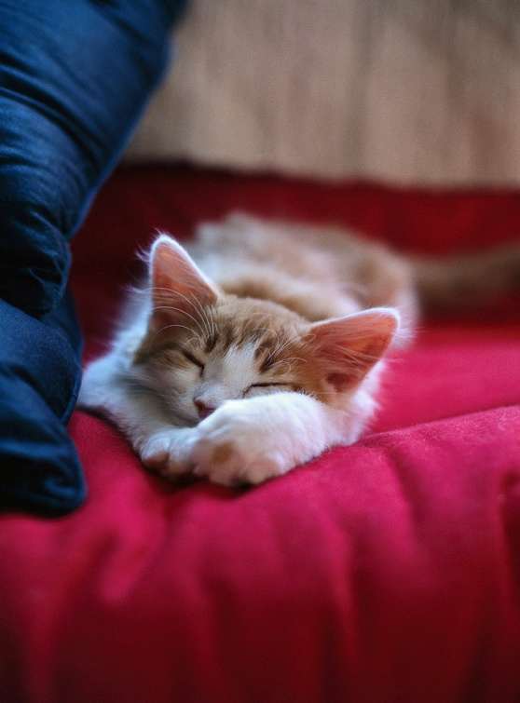
Animals For Adoption
  I’m 8 weeks old
  I’m a girl kitten
  I’m soft and fluffy
  I love children
  My name is Lila

Slide 8
Animals For Adoption
  5 years old
  Orange tabby
  Male
  Loves kids
  All shots

