Slide 1
Word Lesson 3 Helpful Word Features
Microsoft Office 2010 Introductory
Pasewark & Pasewark

Slide 2
Objectives
Use AutoCorrect.
Use AutoFormat As You Type.
Create, insert, and delete Quick Parts.
Use AutoComplete.
Insert the current date and time.
2
2

Slide 3
Objectives (continued)
Check the spelling and grammar in a document.
Use the Thesaurus.
Insert symbols.
3
3

Slide 4
Vocabulary
AutoComplete
AutoCorrect
AutoFormat As You Type
automatic grammar checking
automatic spell checking
building block
contextual spell checking
format
Quick Part
Thesaurus
4
4

Slide 5
Using Automatic Features
Word provides many helpful features and commands including the ability to:
Correct errors automatically
Format text automatically
Save and reuse text that is used often
Check spelling and grammar
Find synonyms for a word
5
5

Slide 6
Understanding Automatic Features
The AutoCorrect feature corrects errors as you type, and AutoFormat As You Type applies built-in formats as you type.
You can create and use Quick Parts to insert frequently used text.
The AutoComplete feature “guesses” days of the week and month names as you type, and then suggests the complete word.
6
6

Slide 7
Using AutoCorrect
AutoCorrect corrects common capitalization, spelling, grammar, and typing errors as you type.
You can customize AutoCorrect by adding or removing words or by changing the types of corrections made.
When using AutoCorrect, the correction occurs after you press the spacebar or Enter.
7
7

Slide 8
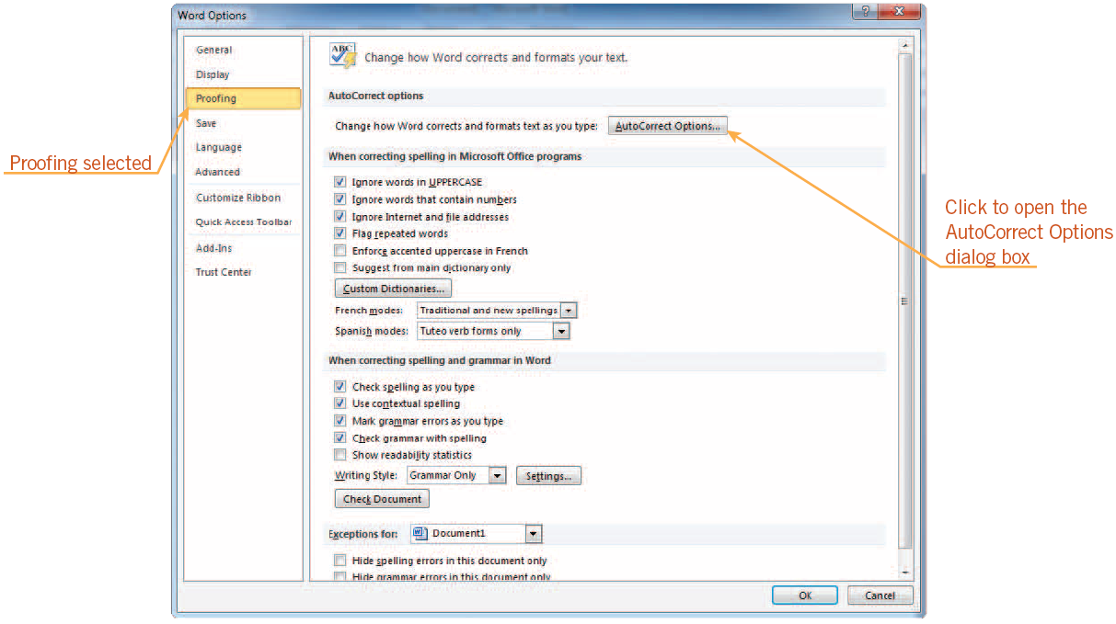
Using AutoCorrect (continued)
Proofing options in the Word Options dialog box
8
8

Slide 9
Using AutoCorrect (continued)
You can add or remove words from the AutoCorrect list and change the AutoCorrect options.
You can also open the AutoCorrect dialog box using the AutoCorrect Options button.
9
9

Slide 10
Understanding Formatting
Formatting means to change the look of text.
You can format words or paragraphs.
Examples of text formatting are adding bold, italics, or underlining to words.
Examples of paragraph formatting are indenting the first line of a paragraph or double-spacing text in a paragraph.
10
10

Slide 11
Using AutoFormat As You Type
The AutoFormat As You Type feature automatically applies built-in formats to text as you type.
You can choose which automatic formatting options you want to use on the AutoFormat As You Type tab in the AutoCorrect dialog box.
11
11

Slide 12
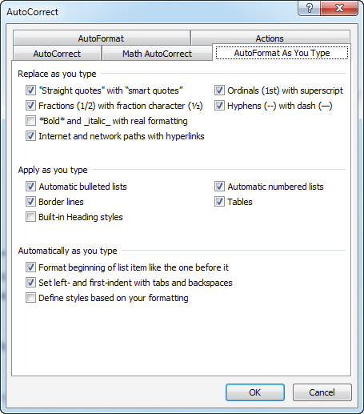
Using AutoFormat As You Type (continued)
AutoFormat As You Type tab in the AutoCorrect dialog box
12
12

Slide 13
Using Quick Parts
Building blocks are document parts that are stored and reused.
Quick Parts are building blocks you create from frequently used text and then save and access quickly by clicking the Quick Parts button in the Text group on the Insert tab.
Building blocks are organized into galleries. A Quick Part you create is stored in the Quick Parts gallery.
13
13

Slide 14
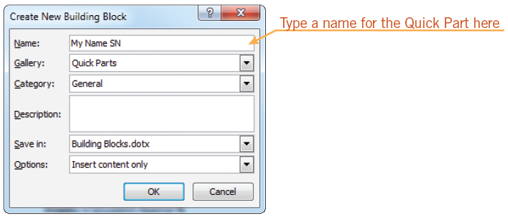
Using Quick Parts (continued)
Create New Building Block dialog box
14
14

Slide 15
Using AutoComplete
AutoComplete is a feature in Word that automatically completes the spelling of days of the week and months of the year that have more than five letters in their names.
After you type the first four letters, AutoComplete suggests the complete word.
15
15

Slide 16
Inserting the Date and Time
You can easily insert the current date and time into a document.
You can also display the current date whenever you open the document.
For example, if you create a report on a regular basis, you would probably want the current date displayed each time you opened the document
16
16

Slide 17
Checking Spelling and Grammar as You Type
Automatic spell checking flags possible misspelled words right after you type them.
A red, wavy underline indicates Word cannot find that word in its built-in dictionary.
A blue, wavy underline indicates a word that might be misused.
With contextual spell checking, Word identifies possible misusage by examining the context in which the word is used.
17
17

Slide 18
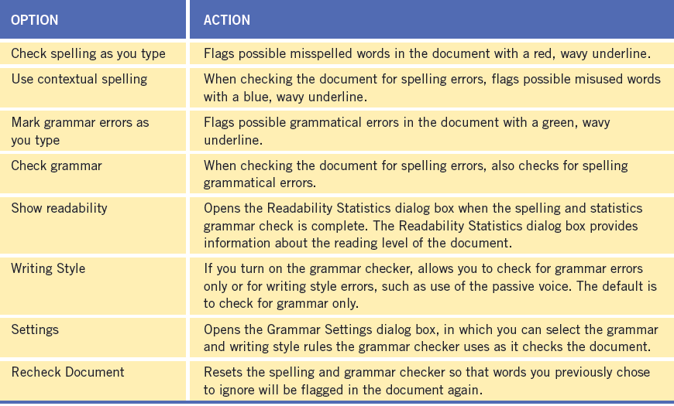
Checking Spelling and Grammar as You Type (continued)
Spelling and grammar options in the Word Options dialog box
18
18

Slide 19
Checking Spelling and Grammar as You Type (continued)
Automatic grammar checking examines your document for grammatical errors.
- When it finds a possible error, the word, phrase, or sentence is underlined with a green, wavy line.
The automatic grammar checker looks for errors such as:
capitalization errors, commonly confused words, misused words, passive sentences, and punctuation problems.
19
19

Slide 20
Checking Spelling and Grammar as You Type (continued)
Automatic grammar checking examines your document for grammatical errors.
When it finds a possible error, the word, phrase, or sentence is underlined with a green, wavy line.
The automatic grammar checker looks for errors such as:
capitalization errors
misused words
commonly confused words
passive sentences
punctuation problems

Slide 21
Using the Spelling and Grammar Checker
You can use the Spelling and Grammar dialog box to check a document’s spelling and grammar after you finish typing. You can check an entire document or a selected portion of a document.
The options in the Spelling and Grammar dialog box change depending on the nature of the current error.
21
21

Slide 22
Using the Thesaurus
The Thesaurus is a useful feature for finding a synonym (a word with a similar meaning) for a word in your document.
For some words, the Thesaurus also lists antonyms, or words with opposite meanings.
22
22

Slide 23
Inserting Symbols
Commonly used symbols are on the menu.
If a symbol is not on the menu, click More Symbols to open the Symbol dialog box. Once inserted, the new symbol will replace one of the other symbols on the menu to make it easier for you to insert it again.
23
23

Slide 24
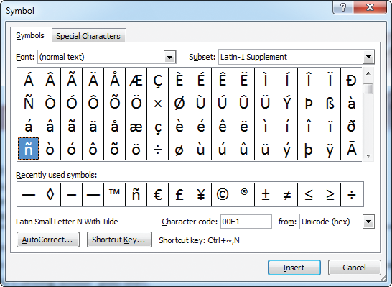
Inserting Symbols (continued)
Symbol dialog box
24
24

Slide 25
Summary
In this lesson, you learned:
AutoCorrect automatically corrects common capitalization and spelling errors as you type. The AutoFormat As You Type feature automatically applies built-in formats to text as you type.
You can create Quick Parts to store frequently used text so you don’t have to retype the text each time. Quick Parts are a type of building block.
AutoComplete automatically completes the spelling of days of the week and months with more than five letters in their names.
25
25

Slide 26
Summary (continued)
You can automatically insert the date and time in a document using the Date & Time button.
Automatic spell checking identifies misspelled words and words that are not in Word’s dictionary by underlining them with a red, wavy underline immediately after you type them. Contextual spell checking identifies words that might be used incorrectly by underlining them with a blue, wavy line.
Automatic grammar checking identifies grammatical errors by underlining the word, phrase, or sentence with a green, wavy line.
26
26

Slide 27
Summary (continued)
The Spelling and Grammar dialog box contains options that allow you to check the spelling and grammar of words, make changes, and add words to your own custom dictionary.
You can use the Thesaurus to find a synonym for a word in your document. For some words, the Thesaurus also lists antonyms.
You can insert symbols and special characters not found on the keyboard using the Symbol button on the Insert tab.
27
27

